Slide 1

Movie match for android A penny for your thoughts ltd.
By: Matthew Penny

Slide 2
Table Of Contents

Slide 3
Project Timeline
JUNE 2022
After finishing courses, a proposal was put together, submitted to the school and accepted in time to start the implementation.
JULY 2022
The planning stages took the first few weeks, then into coding, testing and many prototype iterations. A direction change occurred mid month. Documentation started at month end.
AUGUST 2022
Documentation was finalized, stakeholder presentation built, and final bugs were worked on. Application not ready for the Play Store but large leaps in learning were earned.

Slide 4

Application Description
Original Pitch
An app that can help indecisive couples find a match across multiple streaming platforms and genres through a lobby that could be accessed through an OTP and/or hyperlink.
Midterm Pitch
An app that will help connect like minded people and find someone to watch a movie or series with. They could be in the same room or across the country, allowing for people who are isolated to connect with others through similar movie and series preferences.

Slide 5
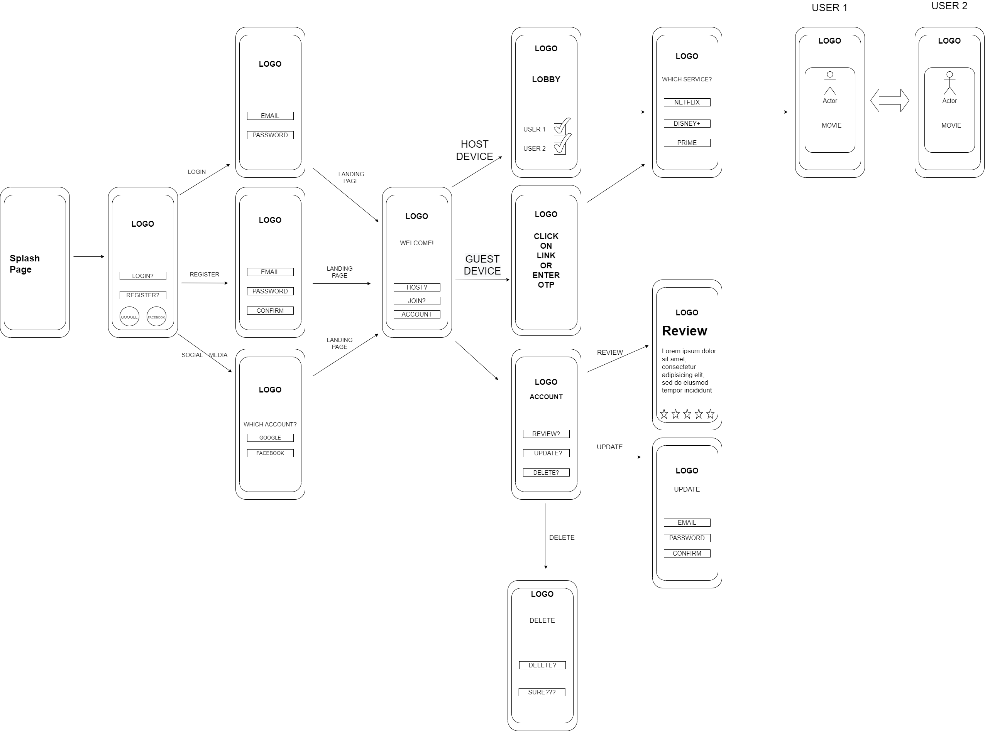
Wireframe Diagram (Original)

Slide 6
Wireframe Diagram (After Change)

Slide 7
DATABASE & CARDINALITIES
Original Database Design
Original Database Cardinalities
Original and Final JSON Trees
Final Database Design
Final Cardinalities

Slide 8
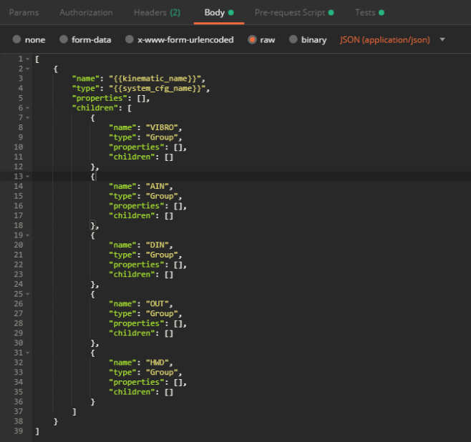
Database Design & Format
We used Firebase for our Database needs, as the fluidity allowed us to make changes on the fly as creating and displaying matches was a large roadblock during the SDLC. Firebase tables are more closely related to JSON trees than a traditional SQL table, which both helped and hindered us during the implementation of the project. Due to a change from the original idea, there are two sets of diagrams.

Slide 9
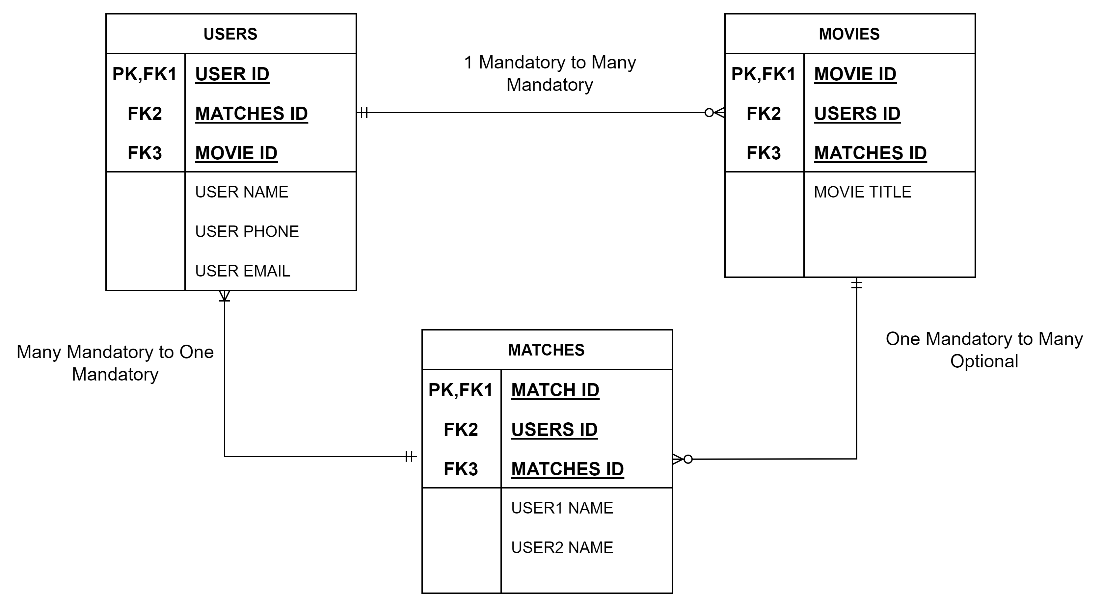
Original Database Cardinalities

Slide 10
Original Database Cardinalities
We looked at the different cardinalities for our project and produced the following set:
Users – One Mandatory to Many Mandatory in relation to Movies table, Many Mandatory to One Mandatory in relation to Matches table.
Movies – Many Optional to Many Optional in relation to Users table, One Mandatory to Many Mandatory in relation to Matches tab
Matches – One Mandatory to Many Mandatory in relation to Users table, Many Optional to One Mandatory in relation to Movies table.

Slide 11
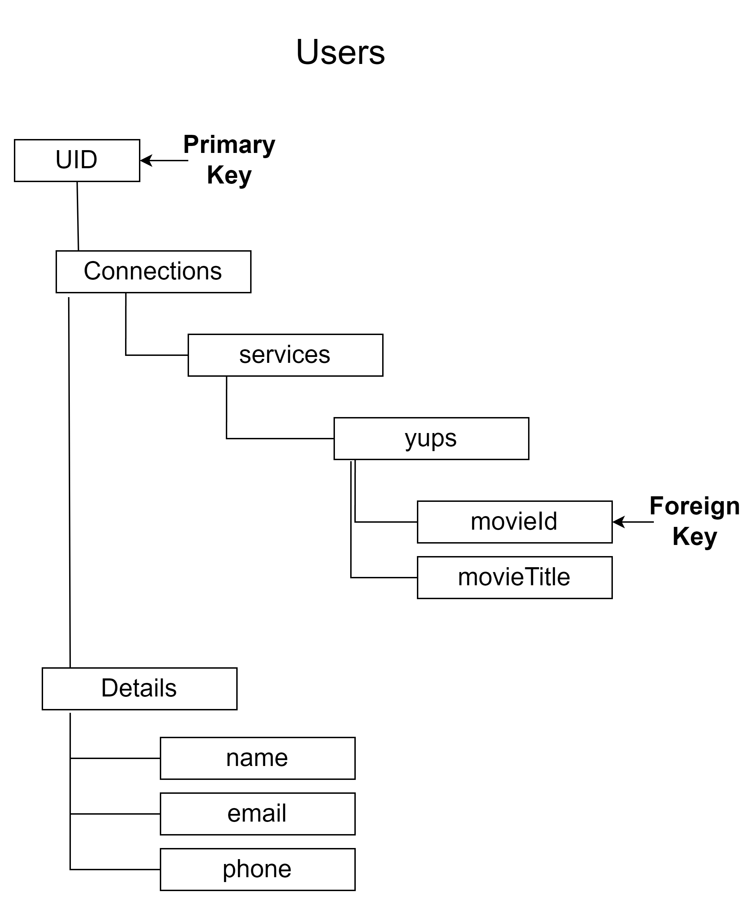
Original JSON Data Tree
UID (User ID) - Generated automatically by Firebase, makes a great PK as it has a unique value.
Connections – Holds all services, as well categorizing the movies confirmed as well as an ID for reference.
Details – Contains all user details, used for displaying in the Match’s table.

Slide 12
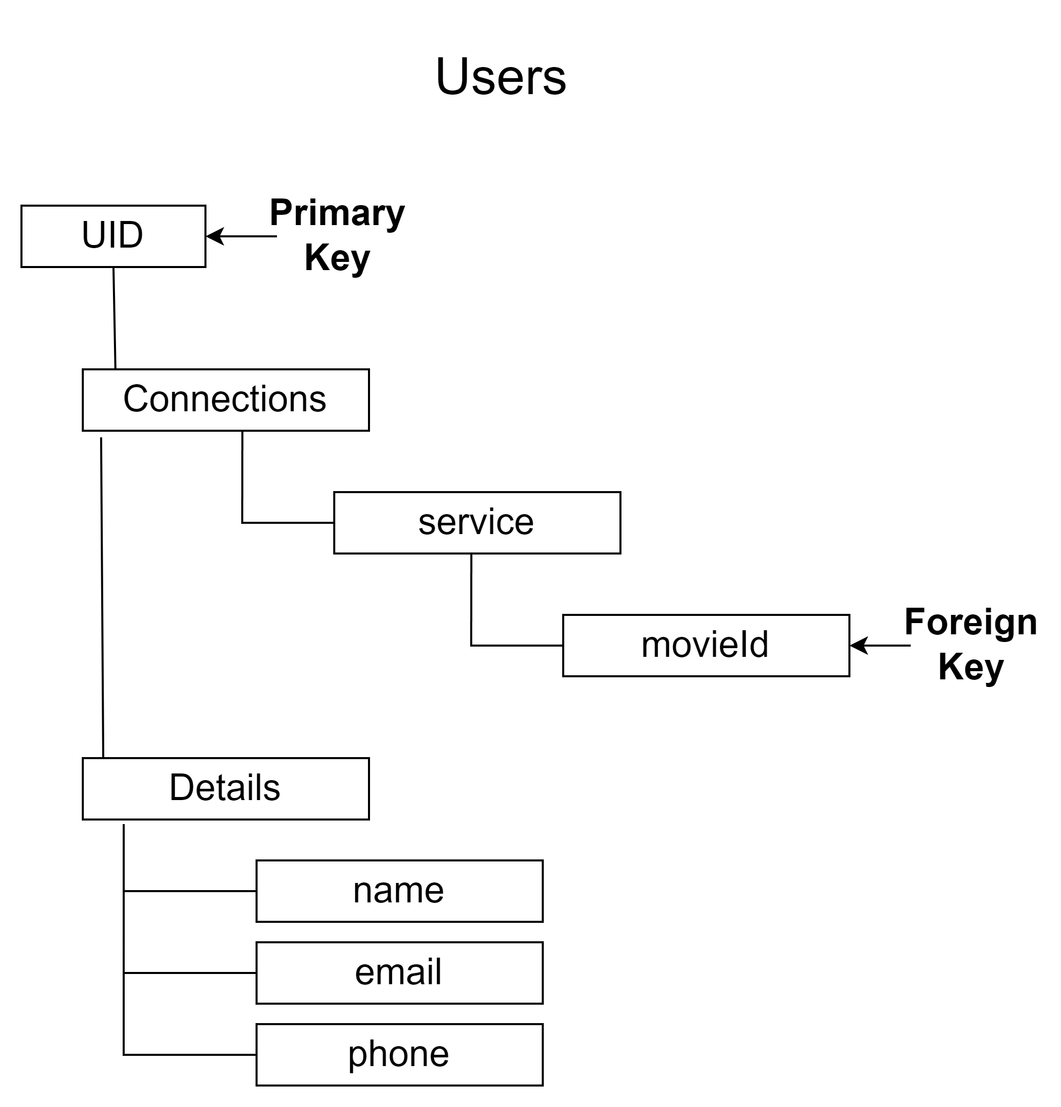
Final Tree Design
We removed the “yups” section from the JSON tree as we discovered that this was an unnecessary node and caused issues when trying to drill down for the information needed.

Slide 13
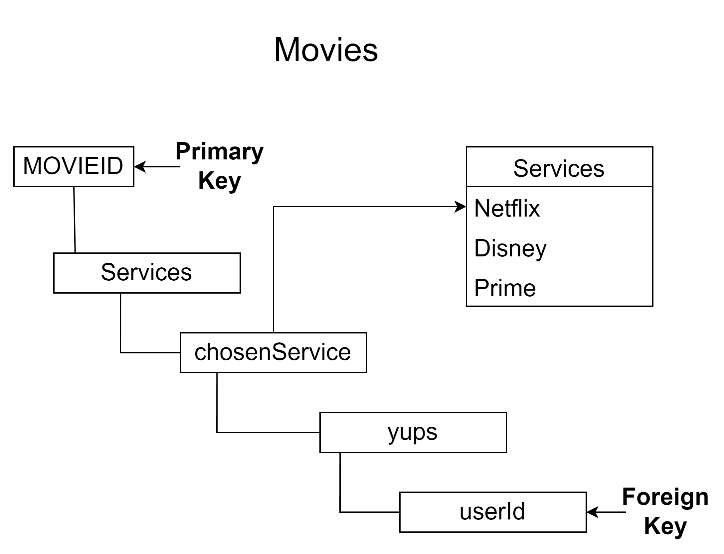
Original JSON Data Tree
MOVIEID – Generated by Firebase, which makes it a great primary key (as mentioned on Users table).
chosenServices – Holds any of the services utilized by the API, helps with sorting the movies and series
userId – Foreign key utilized for reference checks with the Users table

Slide 14
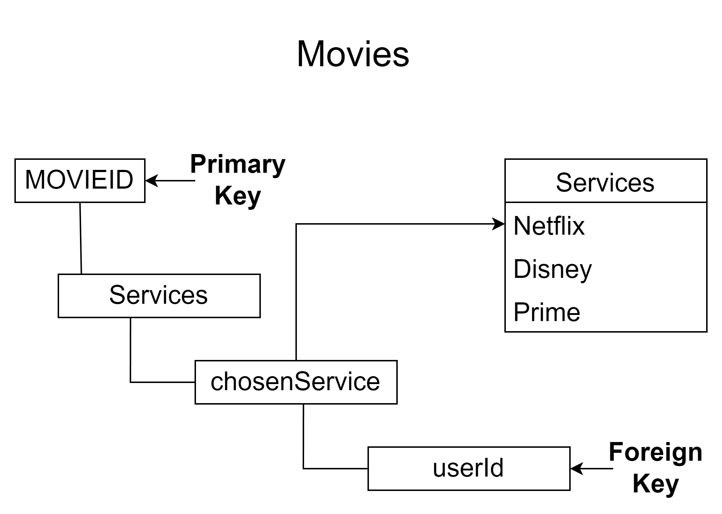
Final Tree Design
There was little to change for the Movies tree except for “yups” node, same as mentioned in the Users tree.

Slide 15
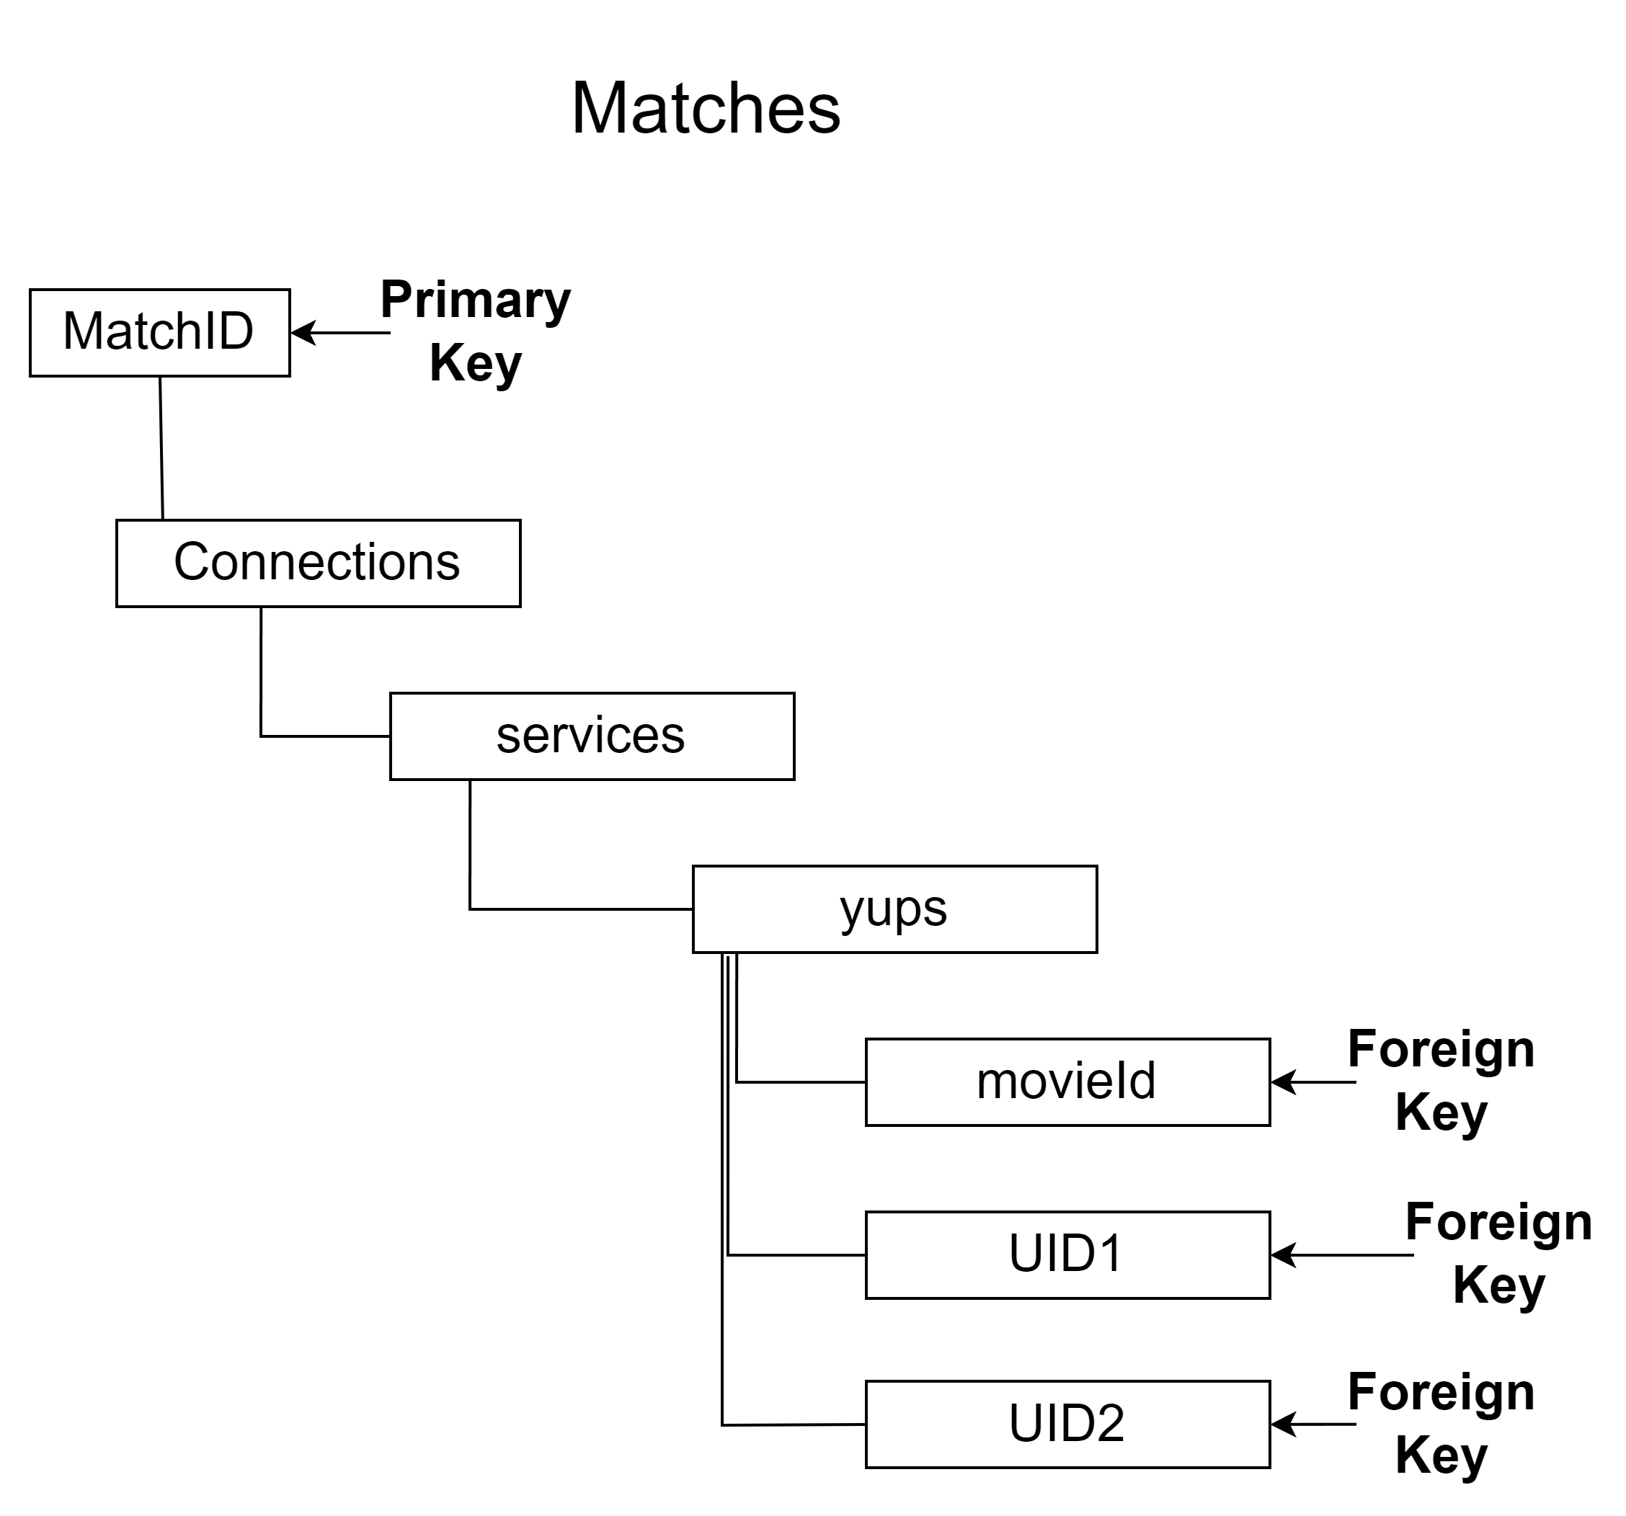
Original JSON Data Tree
MOVIEID – Generated by Firebase, which makes it a great primary key (as mentioned on Users table).
chosenServices – Holds any of the services utilized by the API, helps with sorting the movies and series
userId – Foreign key utilized for reference checks with the Users table

Slide 16
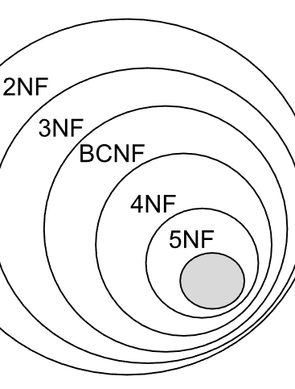
Final Tree Design
After the logic was rebuilt to allow users to match with anyone else who has swiped on the same movie, the Matches table was deemed redundant. As we know, from our Database design courses, its best to run a database through the normalization process to ensure that information isn’t repeated for no reason throughout the entities.

Slide 17
Data flow diagrams

Slide 18
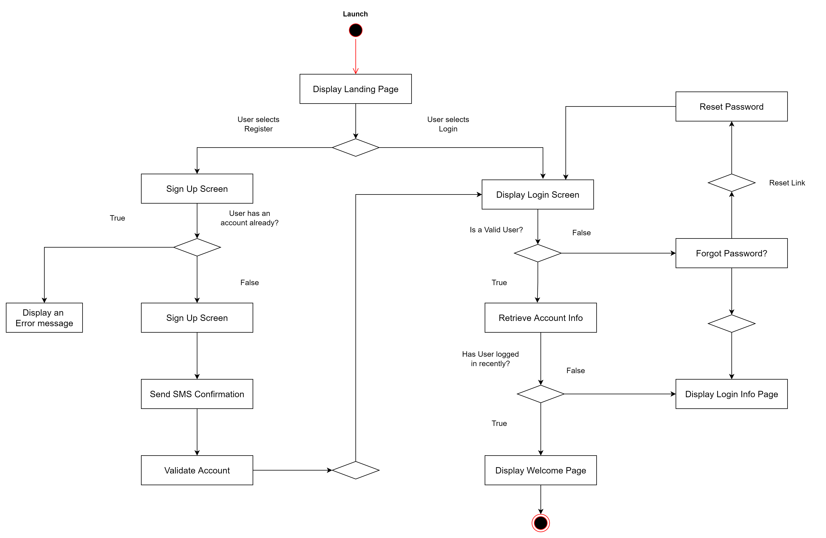
DFD – Login & Register

Slide 19
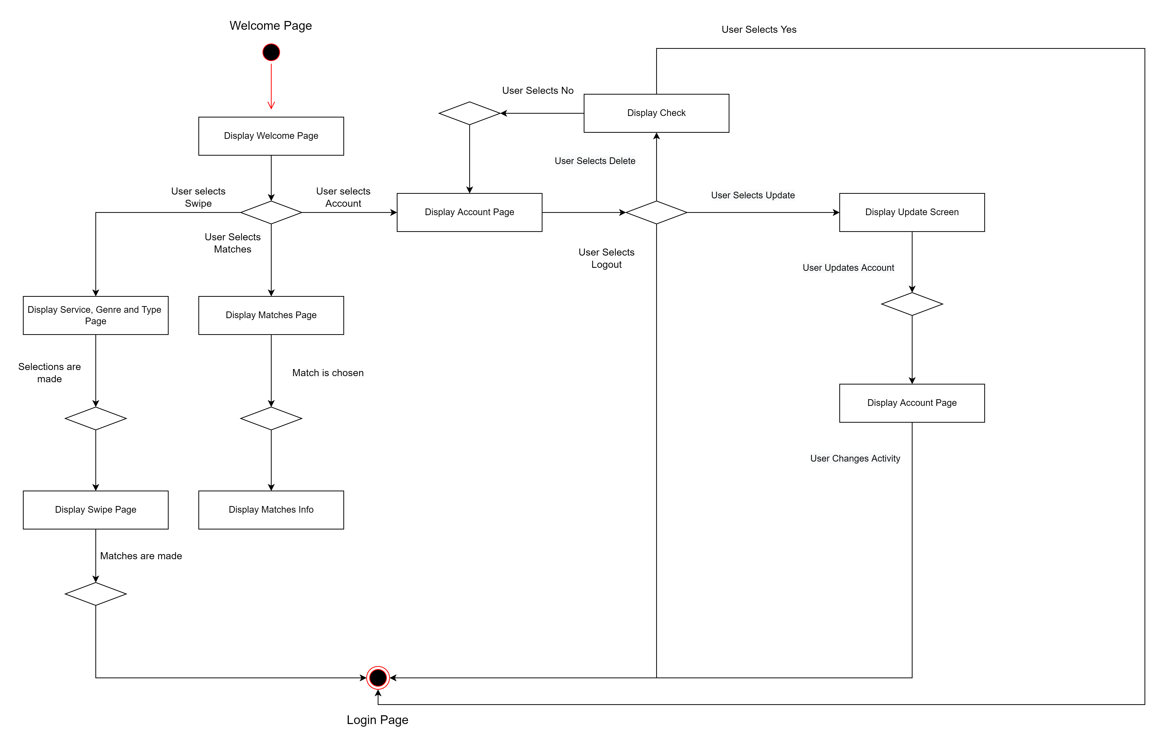
Data flow– service, type & genre

Slide 20
Privacy policy, user manual & Sdd

Slide 21
Privacy Policy
As the application (at the moment) requires a phone number to be able to contact each other’s Matches, we created a Privacy Policy form that will be able to be accessed through the application. We created this with the help from Termly, which ensured that we were able to ensure that we are covered in case of breach.
Here you can see the Privacy Policy:
Privacy Policy

Slide 22

How to Use Manual
Built into the application is the Navigation Drawer Menu. One of the options given here is the “How to Use” manual. This section is a FAQ for users to read and know how the application works without being too heavy or overly technical.

Slide 23
Privacy Policy

Slide 24
Activities at a glance

Slide 25
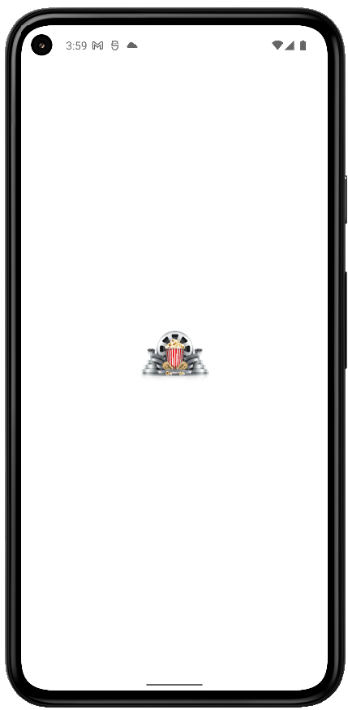
Launch Screen
While launching, we treat the users to the Movie Match logo, with which we hope to invoke some feelings of a few decades ago when theatres were the way to go for a group viewing experience.

Slide 26
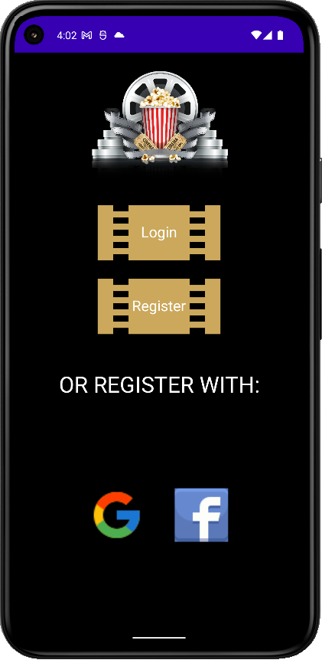
Landing Screen
Landing page shows the login options and will allow users to register using Google, Facebook or the application’s own Firebase authorization by using email and password.

Slide 27
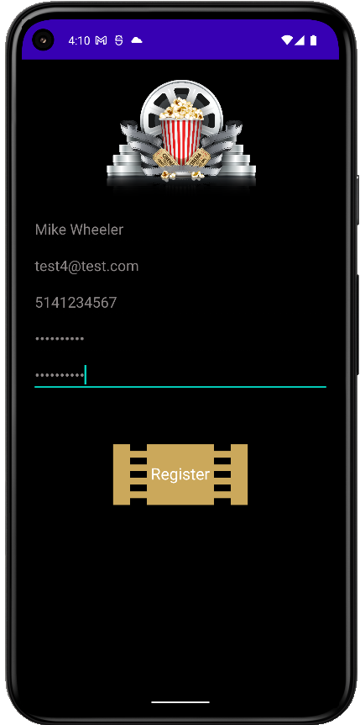
Register Screen
Our register activity allows users to keep their information separate from third party sources and can be assured that their information will be kept secure with Firebase’s security measures.

Slide 28
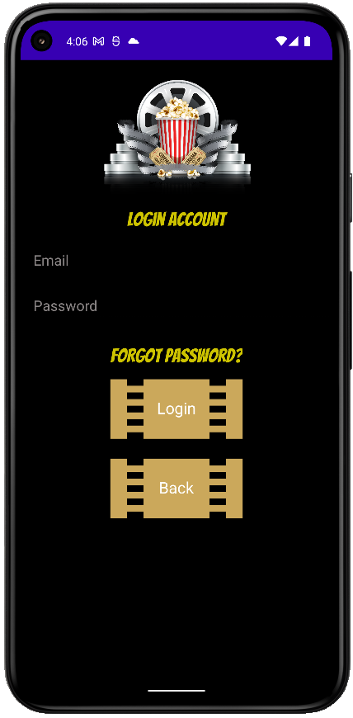
Login Screen
(With Account)In case of a long pause from the application, a change of password or from an accidental logout, this activity will use the credentials from Firebase to login. As well, the “Forgot Password?” link is active here for a quick reset.

Slide 29
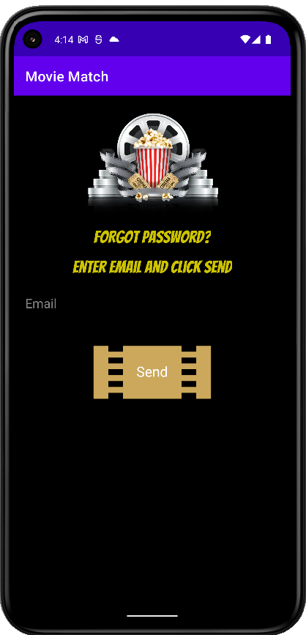
Forgot Password Screen

Slide 30
Swiping and matching

Slide 31
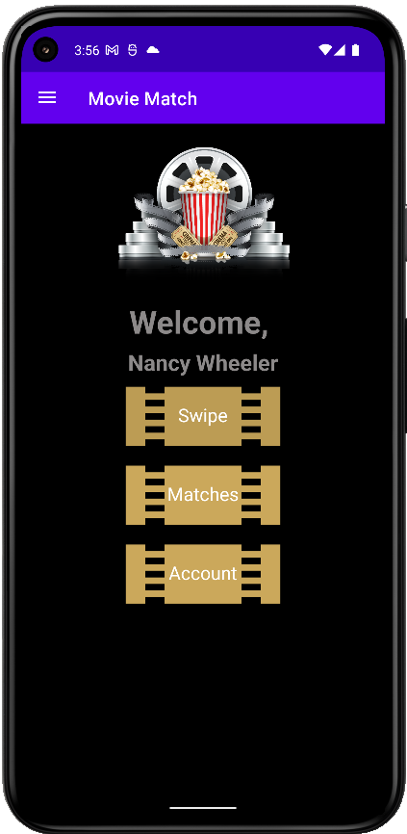
Welcome Screen
From here, we can start move through the main stages of the application in all it’s glory!
Swipe does this…
Matches does that…
Account does the other thing…

Slide 32
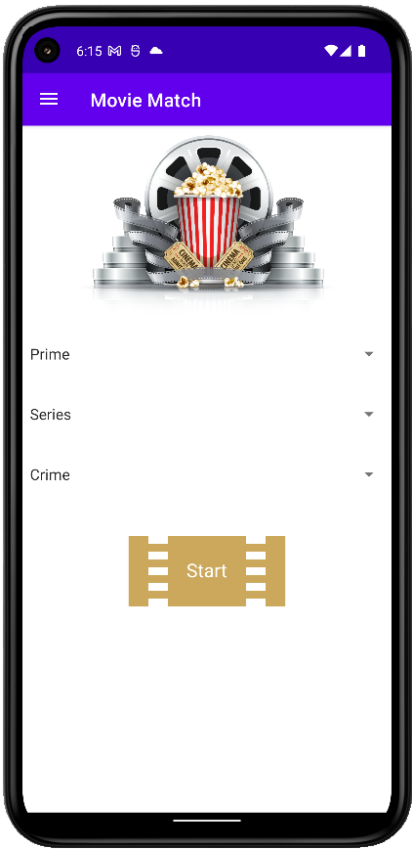
Service, Genre & Type Screen
Choose from:
Services include Prime, Netflix and Disney+
Type includes Movies and Series
Genre holds everything from Action to Sci Fi to Musicals

Slide 33
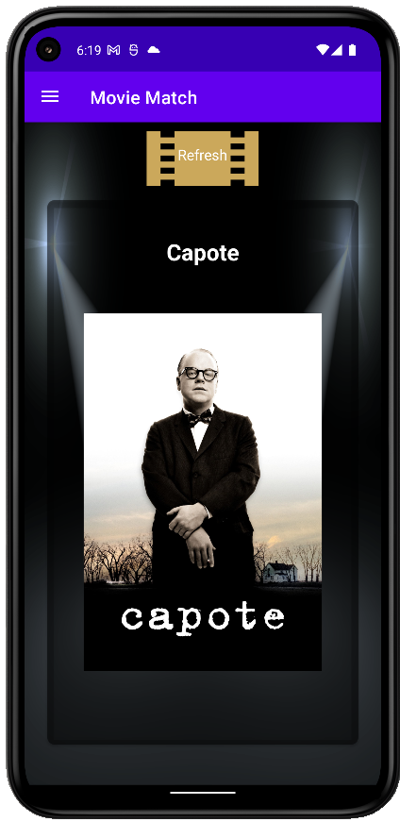
Swipe Screen
The Swipe Activity shows every movie and series available to the API, dependent upon the Service, Genre and Type in groups of 8, as per the API call.
On a single click, we can see details of the film, including runtime, language and year released.
On a long click, we can change the Service so we can see the different movies under the same Genre without changing screens.
If you choose incorrectly, you can push UNDO in the Snackbar prompt.

Slide 34
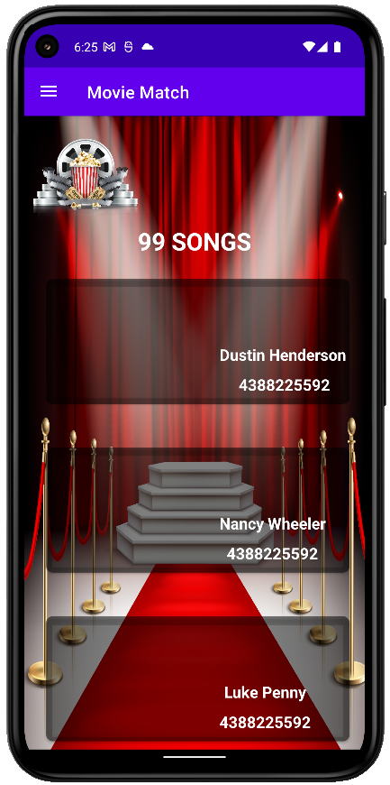
Matches Screen
<<<THIS COULD BE BETTER>>>
Once a movie or series that you like has other users, we are taken to the Matches Activity where we can see the details of other users.
With a single click, we are taken to the Users details card where we can ….

Slide 35
Account page and update

Slide 36
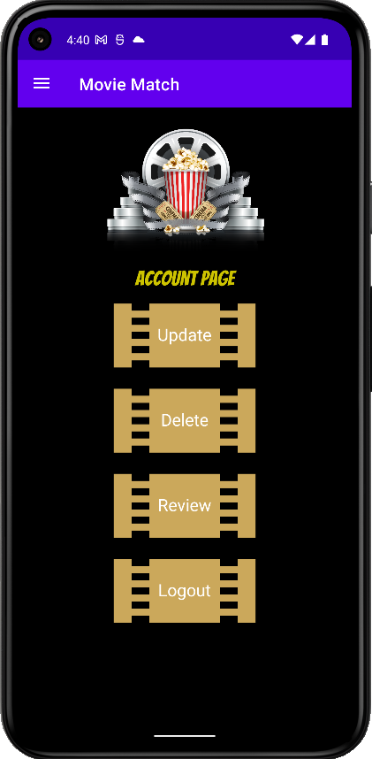
Account Screen
This activity allows the user to:
Update…
Delete…
Review…
Logout…

Slide 37
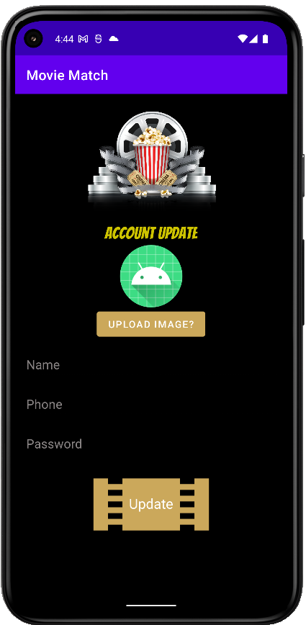
Account Update Screen
The user can update their account information to ensure they appear to their matches as they wish. As well, they can upload an image from their device for other users to see.

Slide 38
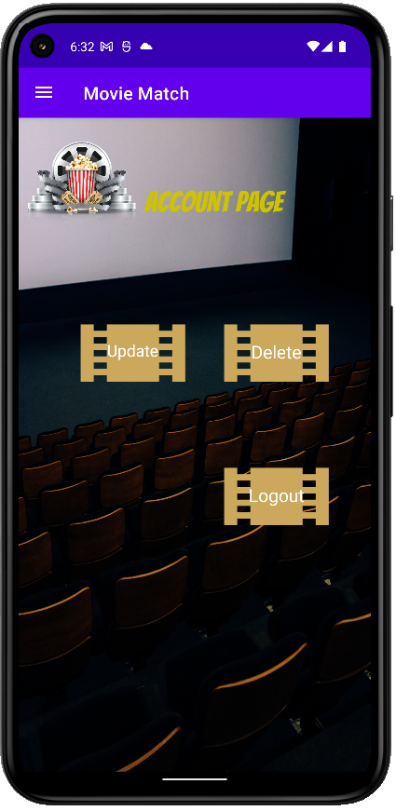
Account Delete Screen
The user can update their account information to ensure they appear to their matches as they wish. As well, they can upload an image from their device for other users to see.

Slide 39
Messaging and contact

Slide 40
Account Screen
This activity allows the user to:
Update…
Delete…
Review…
Logout…

